Slide 1
Rainfall prediction

Slide 2
Our Team
Ramya Edpuganti(700733458)
Kurra Lavanya (700728999 )
Srikavya Gottumukkala(700742824)
Jitheandra Subramaniam(700742721)
.

Slide 3
Roles and responsibilities
Ramya, Lavanya
Project plan
Work allocation
Feature selection
Model creation
Jitheandra, Kavya
Data collection and cleaning
Data visualization
Summarizing the results and conclusion
Ramya, Jitheandra
Web application

Slide 4
Problem statement
Many countries which are majorly dependent on agriculture and poor road systems this project acts as an alert to avoid the loss of crops and human lives.According to the study due to unseasonal rains created havoc in many places leaving the countries in huge economical loss.
In general the meteorology department predicts the rainfall using different methods. These methods are not accessible to other people. While predicting they consider atmospheric parameters into consideration.Based on the past and present data they observe the patterns and make an educated guess to predict the rain.But there is quantitative method to measure the probability of the guess.

Slide 5
Proposed solution
Machine learning offers forecasting models with the given data.The advantage of using machine learning models gives us quantitative analysis.We can predict the accuracy of the classes and different visualizations to filter the outliers in the data and data cleaning.
Machine learning based rainfall prediction is a popular technique nowadays and the models outperform the existing traditional forecast methods.Machine learning methods allows us to gauge the performance of the models with different metrics other than accuracy.

Slide 6
Objectives
The objective of our project is to classify or forecast the rainfall using meteorological parameters using machine learning techniques.Our project is a binary classification problem.
The features of the project include ensemble models and SMOTE oversampling methods. SMOTE balances the imbalance classes for better prediction results.Machine learning Decision tree, Gradient Boosting, AdaBoosting and K-Means clustering algorithms are used to predict next-day rain by training classification models on the target variable Rain Tomorrow.

Slide 7
Motivation
Researchers conclude that climate is a complex model in the analytical world this is called as hard to solve problem. However, with the development of computational methods makes a way to experiment with numerical algorithms to challenge these scenarios.Machine learning is algorithms are part them. Machine learning methods are easy to adopt unlike Deep learning methods which require specific computational power.

Slide 8
Related work
Heavy rainfall is a major concern in many countries because it leads to natural calamities like floods.With this effect there will be a loss of human lives and economical loss for governments.This also affects majorly the countries which are primarily dependent on agriculture.Unseasonal rains damage the crops[2]. Large datasets can not be explored manually for finding the pattern. Exploratory data analysis gives most of the information which is very important to remove the unnecessary data and what methods can be used to predict the results.[4]. On the large set of data classifiers Decision Tree and K-means are performing well and yielding good results in terms of accuracy and other metrics F1-score, recall and precision.In the weather forecasting problem we can not depend on single metric like accuracy.Accuracy metric only gives the overall view of the solution and the performance[3].

Slide 9
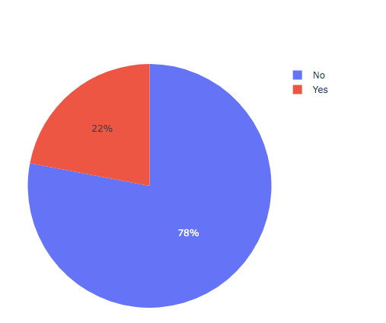
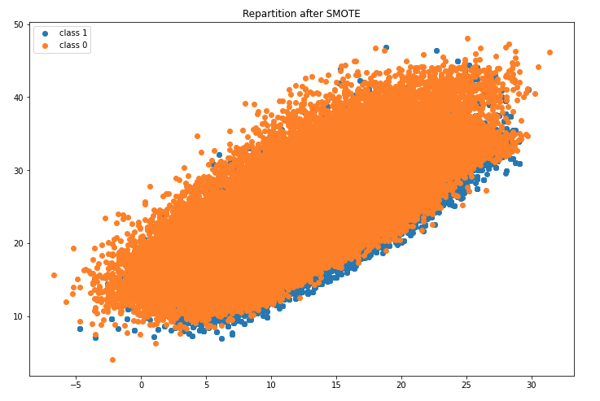
Results
Since the target classes are imbalance SMOTE analysis is applied to make the target classes balanced.Figure 1 on the left shows the pie chart of target classes and the figure 2 on the right shows the scatter plot of the balanced classes.

Slide 10
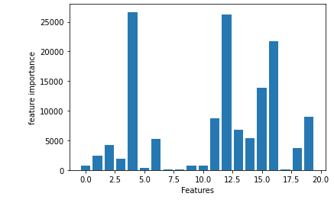
Results
After balancing the classes ANOVA feature selection is applied to select the important features from the dataset.
The figure on the left hand side shows the feature importance score vs the features.
ANOVA feature selection is implemented using sklearn

Slide 11
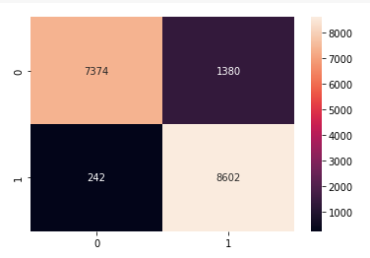
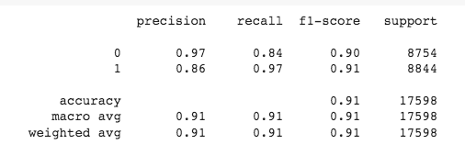
Results
After feature selection Decision tree classifier,Gradient Boosting, Ada boosting and K means classifiers used for binary classification.The above figures show the confusion matrix and classification report for decision tree classifier.Test accuracy of the decision tree classifier is 91%.

Slide 12
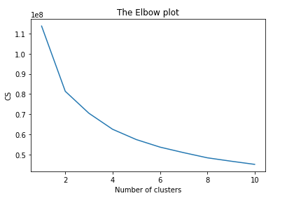
Results
In addition to supervised learning algorithms, K means clustering algorithm which is an unsupervised learning algorithm also used to test the performance of the classification.
88 % of the accuracy is achieved with K- means clustering. An elbow plot is used to find the optimal number of clusters which is 2.

Slide 13
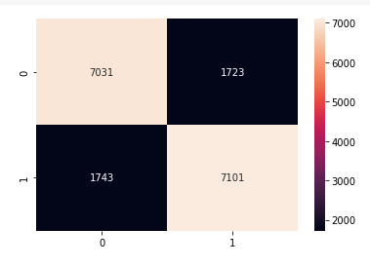
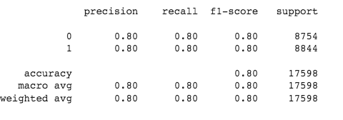
Results
The above figures are classification report and confusion matrix of Gradient boosting algorithm.
Test accuracy of the Gradient Boosting is 80%.

Slide 14
References
[1].D. Karthika and K. Karthikeyan, "Analysis of Mathematical Models for Rainfall Prediction Using Seasonal Rainfall Data: A Case Study for Tamil Nadu, India," 2022 First International Conference on Electrical, Electronics, Information and Communication Technologies (ICEEICT), 2022, pp. 01-04, doi: 10.1109/ICEEICT53079.2022.9768602.
[2].D. Karthika and K. Karthikeyan, "Analysis of Mathematical Models for Rainfall Prediction Using Seasonal Rainfall Data: A Case Study for Tamil Nadu, India," 2022 First International Conference on Electrical, Electronics, Information and Communication Technologies (ICEEICT), 2022, pp. 01-04, doi: 10.1109/ICEEICT53079.2022.9768602.
[3].S. Biruntha, B. S. Sowmiya, R. Subashri and M. Vasanth, "Rainfall Prediction using kNN and Decision Tree," 2022 International Conference on Electronics and Renewable Systems (ICEARS), 2022, pp. 1757-1763, doi: 10.1109/ICEARS53579.2022.9752220.
[4].Y. K. Joshi, U. Chawla and S. Shukla, "Rainfall Prediction Using Data Visualisation Techniques," 2020 10th International Conference on Cloud Computing, Data Science & Engineering (Confluence), 2020, pp. 327-331, doi: 10.1109/Confluence47617.2020.9057928.

Slide 15

THANKS!
Any questions?

